Slide 1
Realtime Multi-Person 2D Pose Estimation using Part Affinity Fields

Slide 2
Part Affinity Fields
A PAF is a set of 2D vector fields that encode the location and orientation of the limbs.
Suppose you have already detected all body parts (hands, elbows, feet, ankles etc.); how do you now generate poses from them? First, you must find out how to connect two points to form a limb. For each body part, there are several candidates to form a limb: there are multiple people on the image, and there also can be lots of false positives. We need some confidence measure for the association between each body part detection.

Slide 3
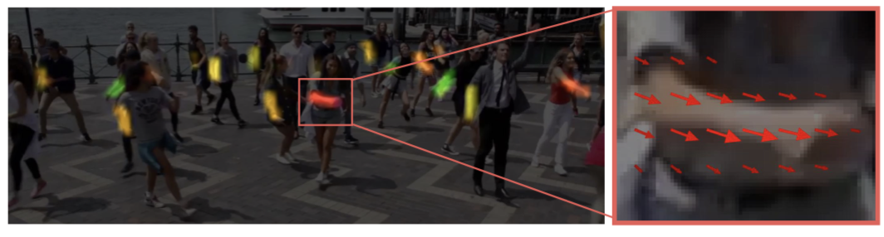
In essence a PAF is a set of vectors that encodes the direction from one part of the limb to the other; each limb is considered as an affinity field between body parts.

Slide 4
If a point lies on the limb then its value in the PAF is a unit vector pointing from starting joint point to ending joint point of this limb; the value is zero if it is outside the limb. Thus, PAF is a vector field that contains information about one specific limb for all the people on the image, and the entire set of PAFs encodes all the limbs for every person.

Slide 5
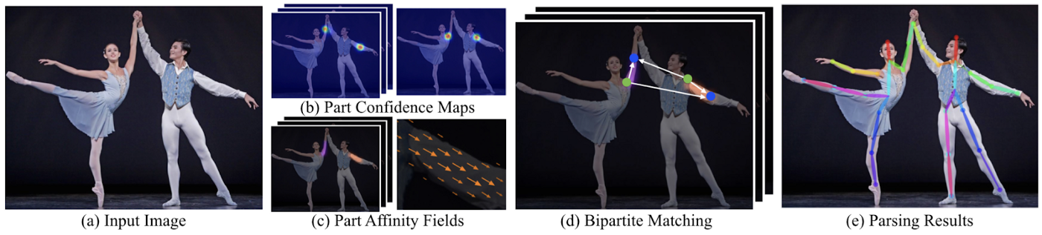
Overview

Slide 6
First, a feedforward neural network predicts a set of body part locations on the image in the form of a confidence map and a set of PAFs that encode the degree of association between these body parts. Thus, the algorithm gets all information necessary for further matching of limbs and people.
Next, confidence maps and affinity fields are parsed together to output the final positions of limbs for all people on the picture.

Slide 7
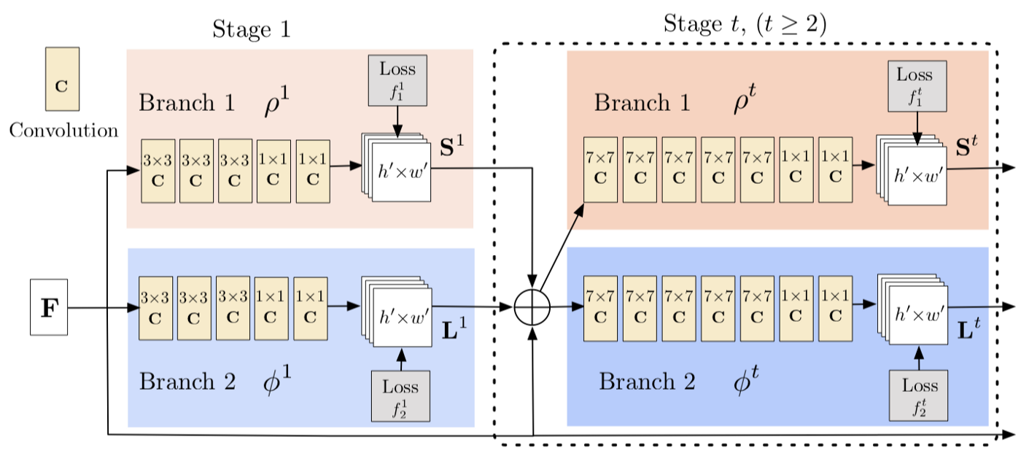
Architecture

Slide 8
Core Idea: simultaneously predict detection confidence map and affinity fields.
The top branch predicts the detection confidence maps and the bottom branch is for affinity fields. Both branches are organized as an iterative prediction architecture, which refines predictions over successive stages
Before passing input to this two-branch network the method uses auxiliary CNN (first 10 layers of VGG-19) to extract an input feature map F. This prediction is processed by both branches, and their predictions concatenated with initial F are used as input for the next stage (as features).
At the end of each stage, the corresponding loss function is applied for each branch to guide the network.

Slide 9
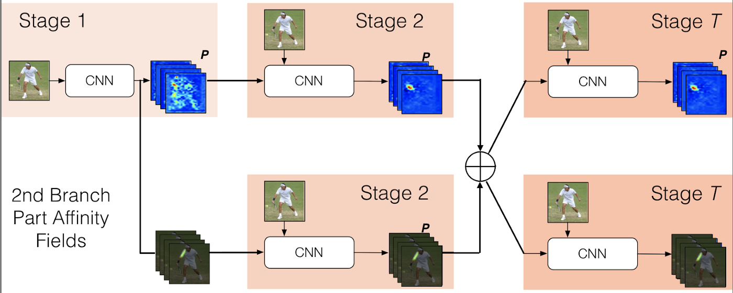

Slide 10
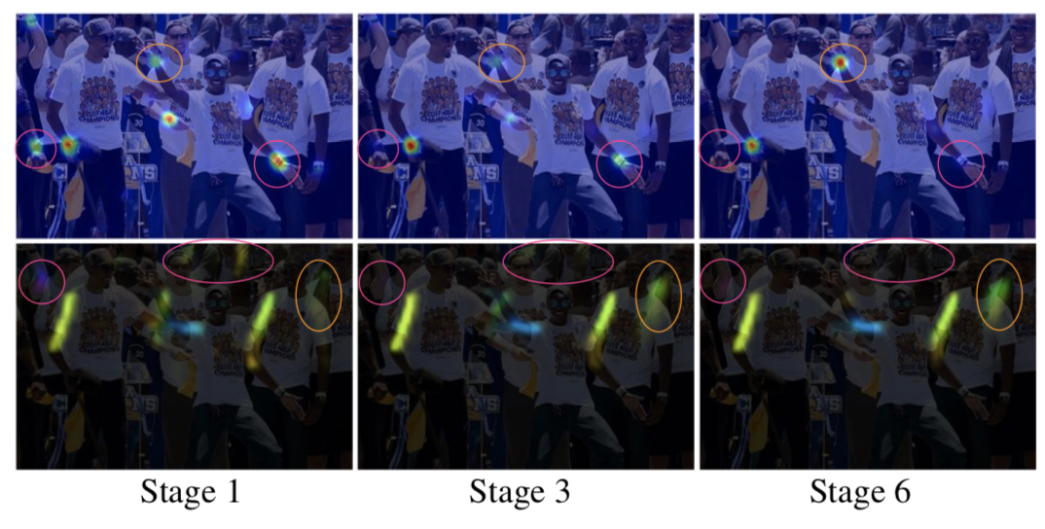

Slide 11
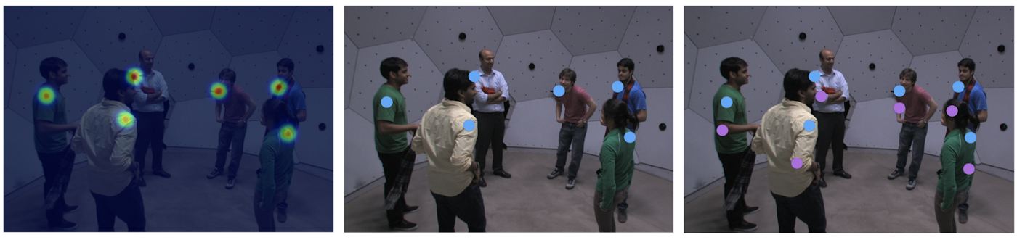

Slide 12
Full Body Model
We need to somehow connect all these limbs into people.
This problem can be viewed as a k-partite graph matching problem, where nodes of the graph are body part detections, and edges are all possible connections between them (possible limbs). Here k-partite matching means that the vertices can be partitioned into k groups of nodes with no connections inside each group

Slide 13
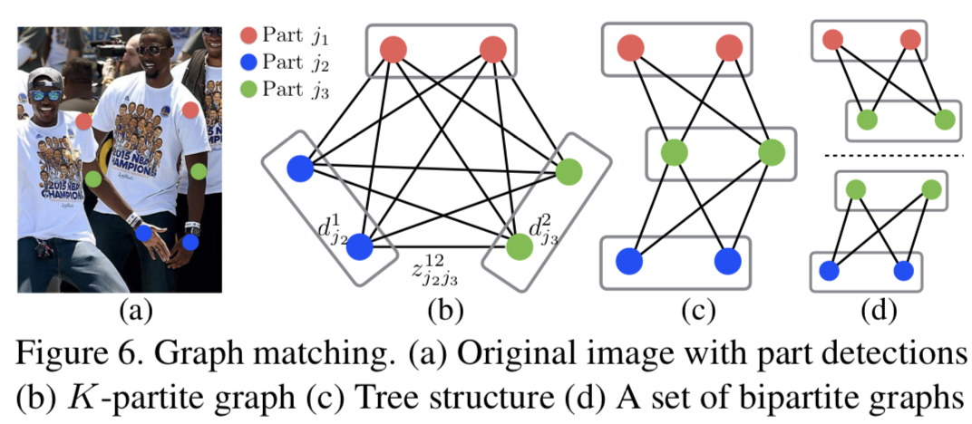

Slide 14

Results

Slide 15


Slide 16
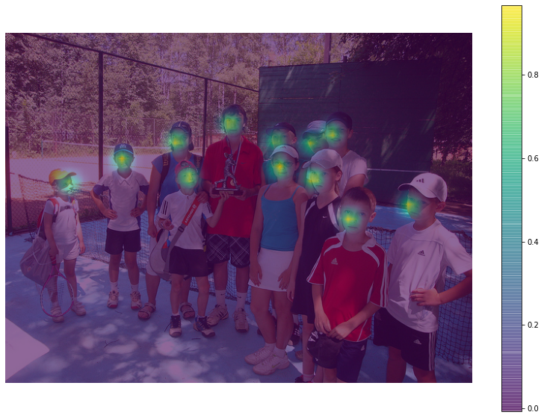

Slide 17
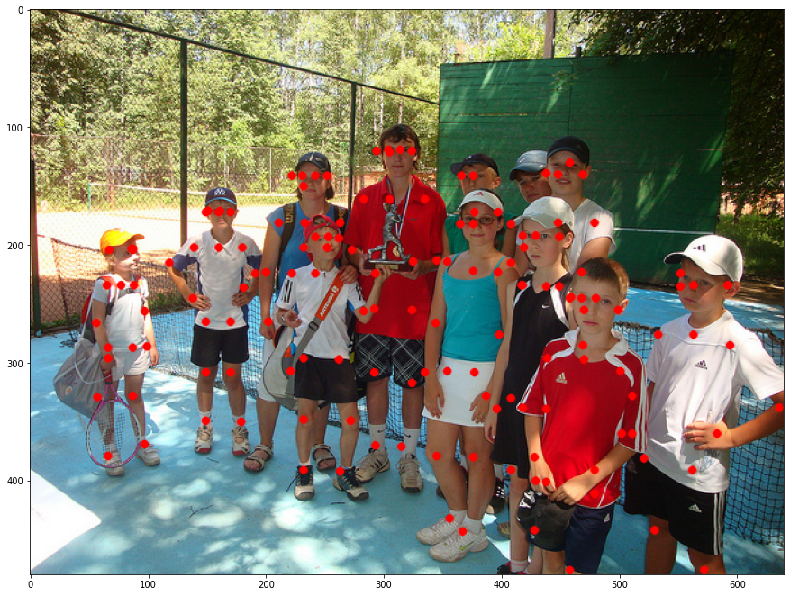

Slide 18
